Slide 1
COVID – 19 CASE ANALYSIS
TEAM LEADER
R.VISHNU
TEAM MEMBERS
P.VINOTH KUMAR
S.SUJITH KUMAR
C.PRIYA DHARSINI
A.STEPHEN KOVIL PILLAI

Slide 2
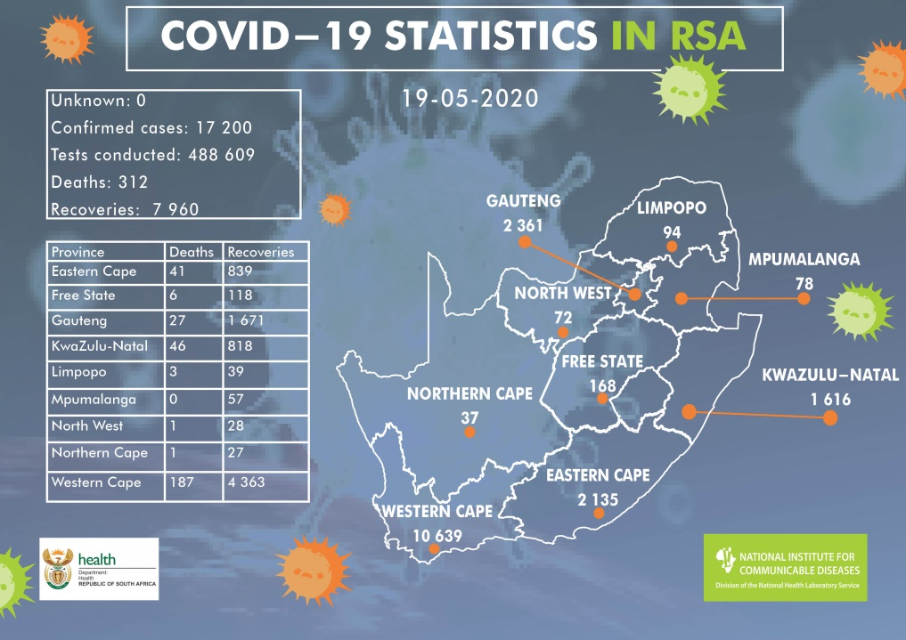
COVID – 19
Coronavirus disease 2019 (COVID-19) is the official name given by the World Health Organization (WHO) to the disease caused by SARS-CoV-2, the new coronavirus that surfaced in Wuhan, China in 2019 and spread around the globe.

Slide 3
TOPICS COVERED IN THIS PRESENTATION
INTRODUCTION
WHAT IS COVID-19?
DATA EXTRACTION
HANDLING THE MISSING VALUE
DATA VISUALIZATION
PIE CHART
IMPACT OF COVID
EVIDENCE OF COVID INFECTIONS
GLOBAL COVID OVERVIEW
CONCLUSION

Slide 4

WHAT IS COVID-19? COVID-19 is caused by the SARS-CoV-2 virus and was first identified in December 2019 in Wuhan, China. The virus quickly spread globally, leading to a pandemic. It primarily spreads through respiratory droplets and symptoms include fever, cough, and shortness of breath.
INTRODUCTION
The COVID-19 pandemic, caused by the novel coronavirus SARS-CoV-2, has had a profound and lasting impact on global health, economies, and daily life. Since its emergence in late 2019, COVID-19 has spread rapidly across the world, leading to millions of infections and deaths. Understanding and analyzing the various aspects of this pandemic, such as its epidemiology, public health responses, medical developments, and societal consequences, is essential for both present and future preparedness.

Slide 5
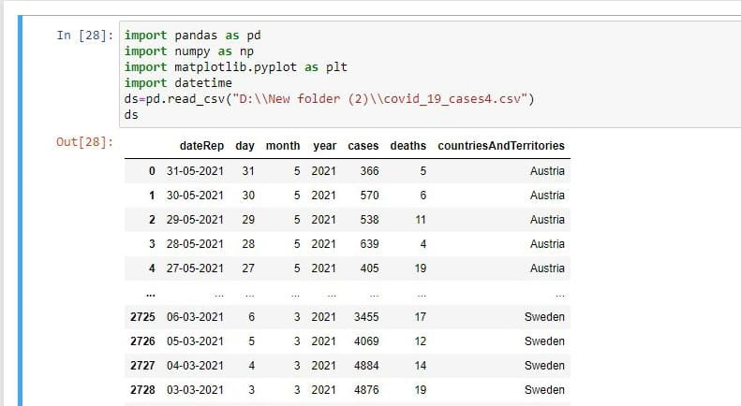
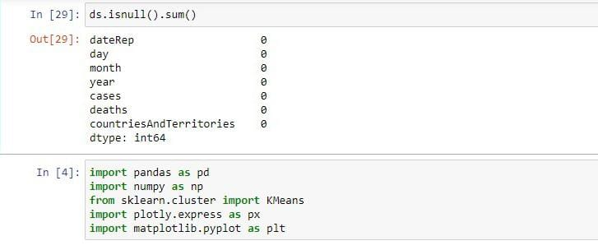
HANDLING THE MISSING VALUES Filling the missing data with the mean or median value if it's a numerical variable. Filling the missing data with mode if it's a categorical value. Filling the numerical value with 0 or -999, or some other number that will not occur in the data.
DATA EXTRACTION
Data extraction is the process of obtaining raw data from a source and replicating that data somewhere else. The raw data can come from various sources, such as a database, Excel spreadsheet, an SaaS platform, web scraping, or others.

Slide 6
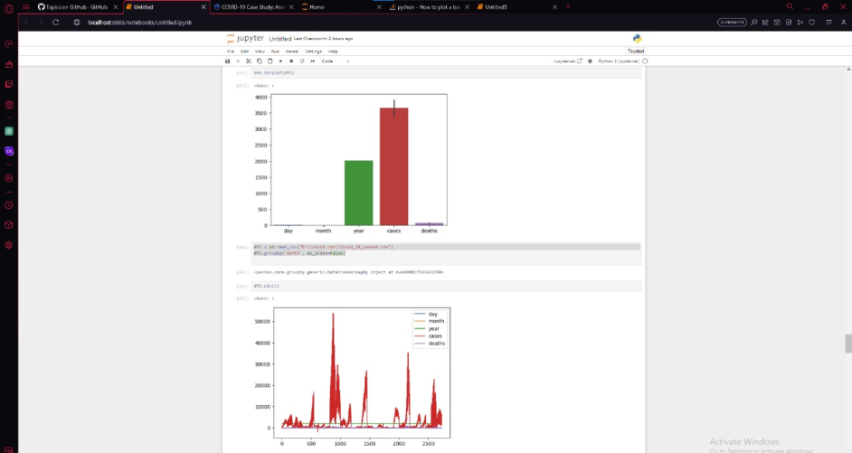
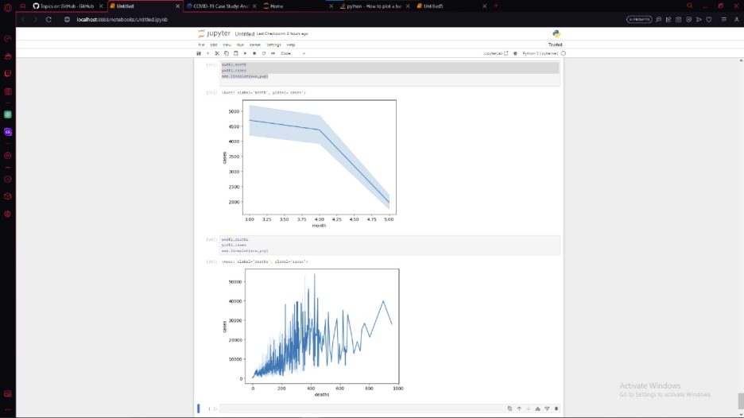
DATA VISUALIZATION Data visualization is the graphical representation of information and data. By using visual elements like charts, graphs, and maps, data visualization tools provide an accessible way to see and understand trends, outliers, and patterns in data

Slide 7
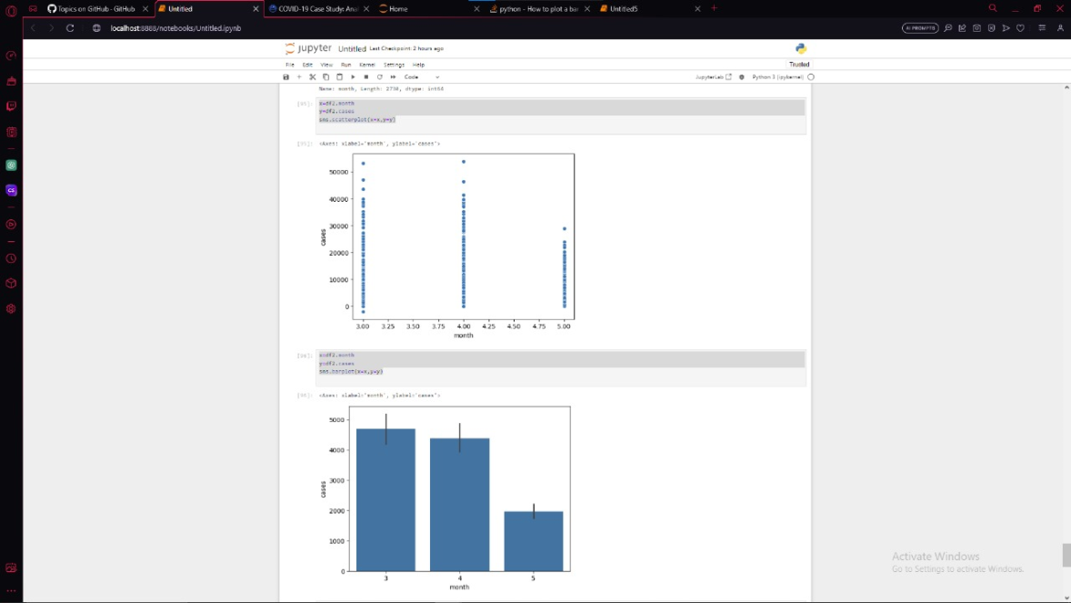
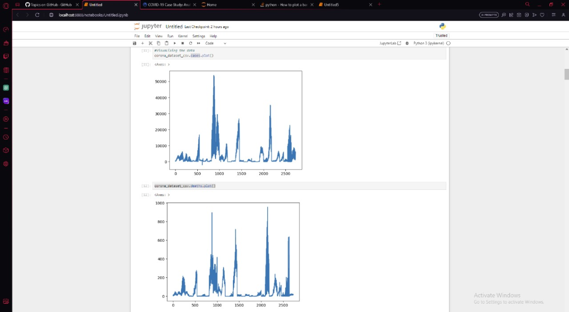

Slide 8
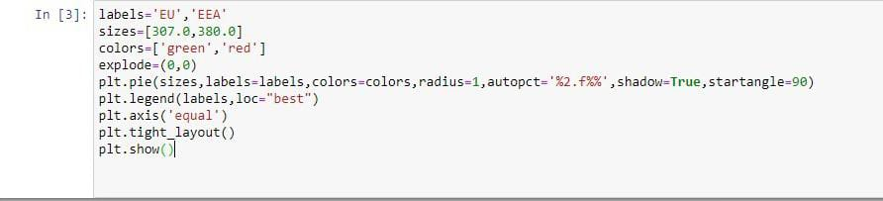
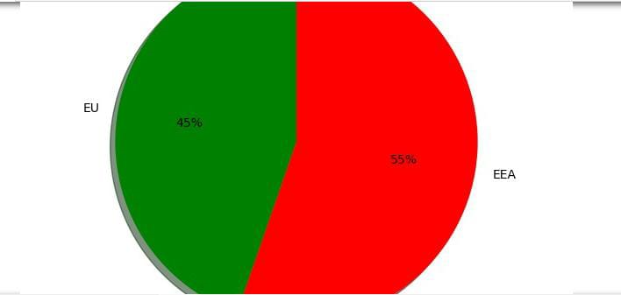
PIE CHART

Slide 9
IMPACTS BY CORONA
The rapid spread of the COVID-19 pandemic has led to a high death rate and, therefore, negatively impacts mental health, thus causing social concerns due to government restrictions (confinement, curfew, etc.)
EVIDENCE OF COVID INFECTION
Fever or chills
Cough
Shortness of breath or difficulty breathing

Slide 10
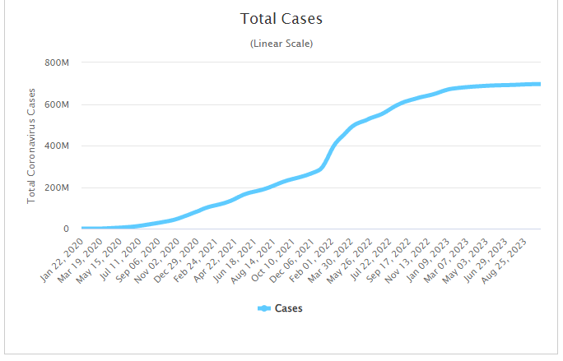

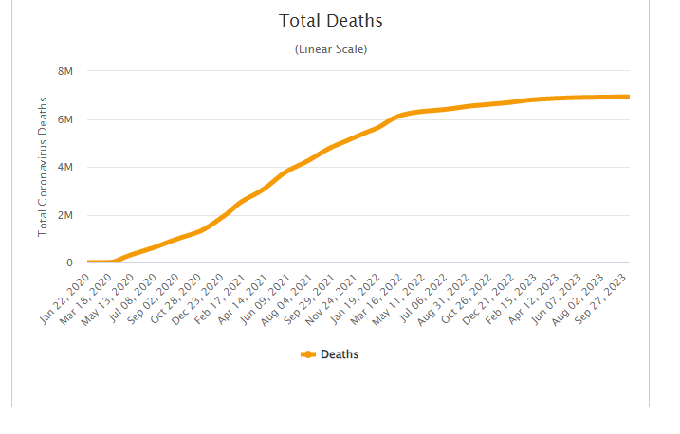
Global covid overview
WHO provides a overview of the
World level corona.
Corona case – 696443247
Recovery cases – 689518130
Death rates - 6925117

Slide 11

CONCLUSION
The COVID-19 pandemic has had a significant impact on the world. It has highlighted the importance of preparedness, collaboration, and innovation. While the future outlook is uncertain, we have learned many lessons that will help us better prepare for future pandemics.

